Slide 1
DESIGN CREDIT PROJECT
Image Text Conversion
(Hindi->English and English->Hindi)
Under Guidance of:
Prof.Anand Mishra
Contributors:
Yateen(B23CS1082)
Pawar Yuvraj Pramod (B23CS1051)
Neeraj Mansingh (B23CS1095)

Slide 2

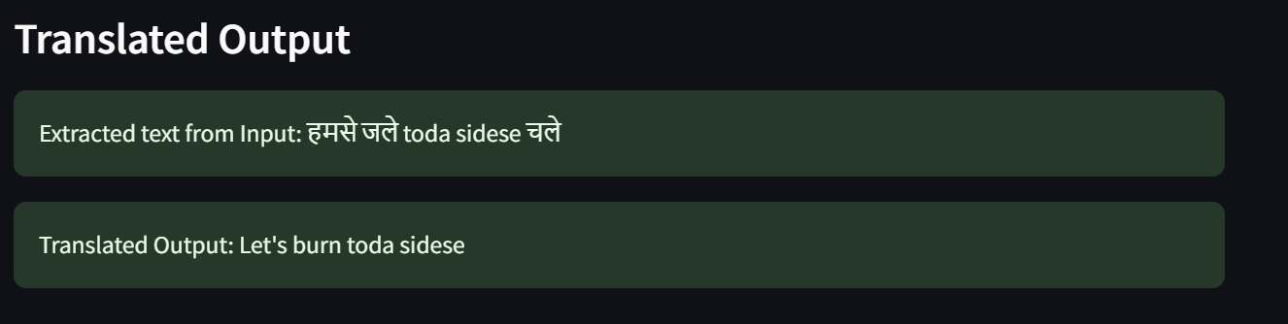
Model Selected: Hindi to English
Uploaded Image

Slide 3

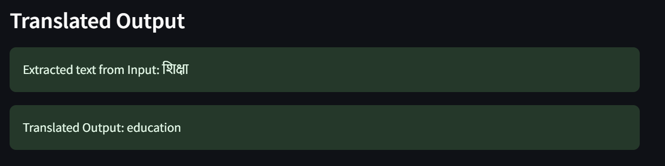
Model Selected: Hindi to English
Uploaded Image

Slide 4
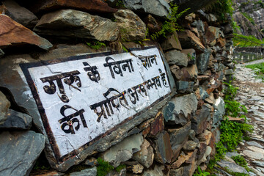
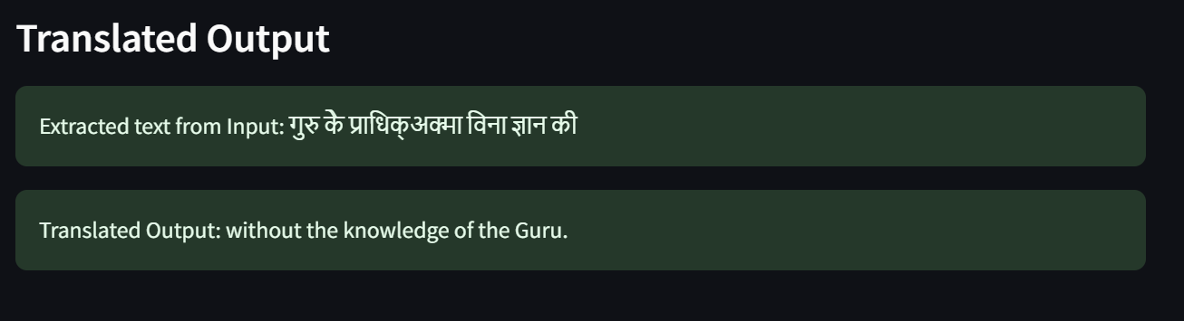
Model Selected: Hindi to English
Uploaded Image

Slide 5

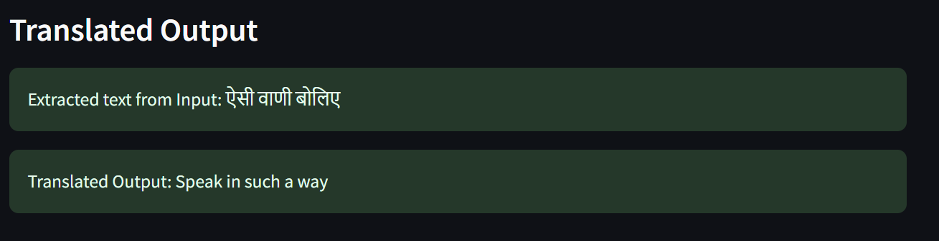
Model Selected: Hindi to English
Uploaded Image

Slide 6
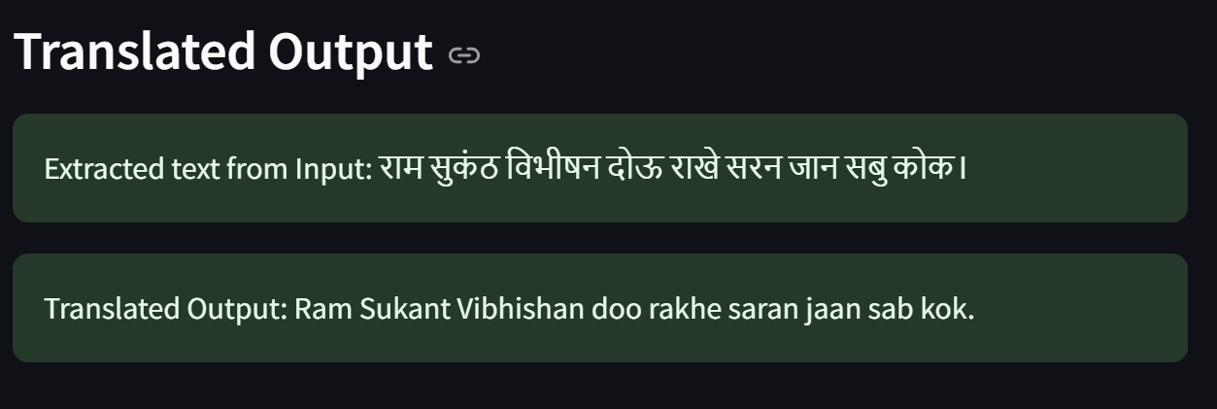
Model Selected: Hindi to English
Uploaded Image

Slide 7


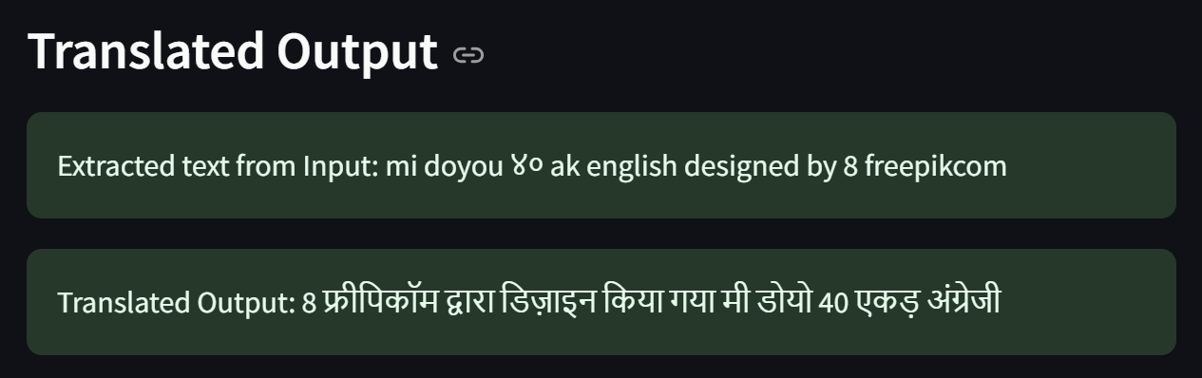
Model Selected:
Uploaded Image

Slide 8

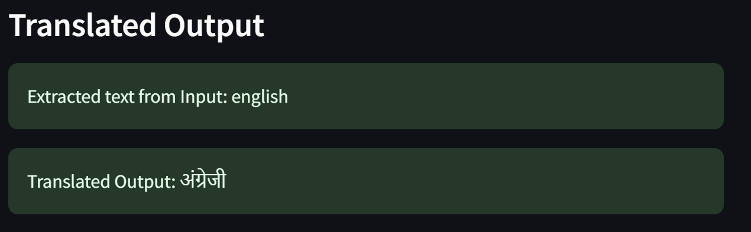
Model Selected:
Uploaded Image

Slide 9

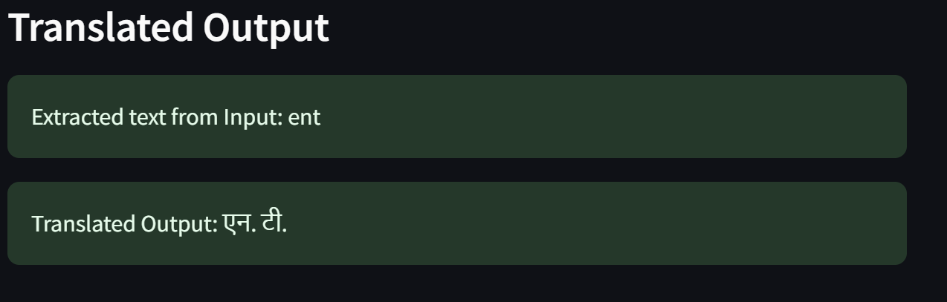
Model Selected:
Uploaded Image

Slide 10

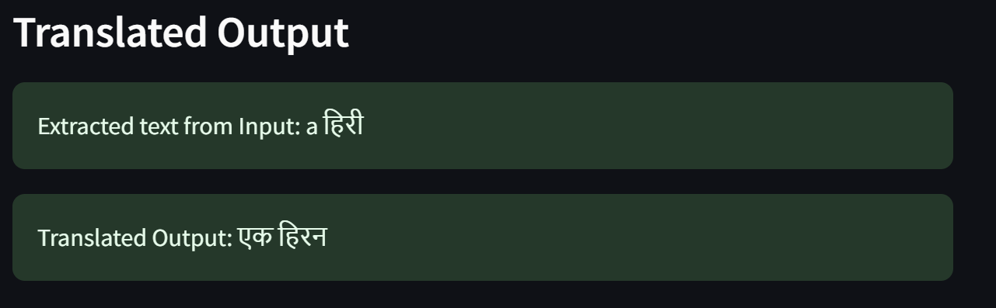
Model Selected:
Uploaded Image

Slide 11

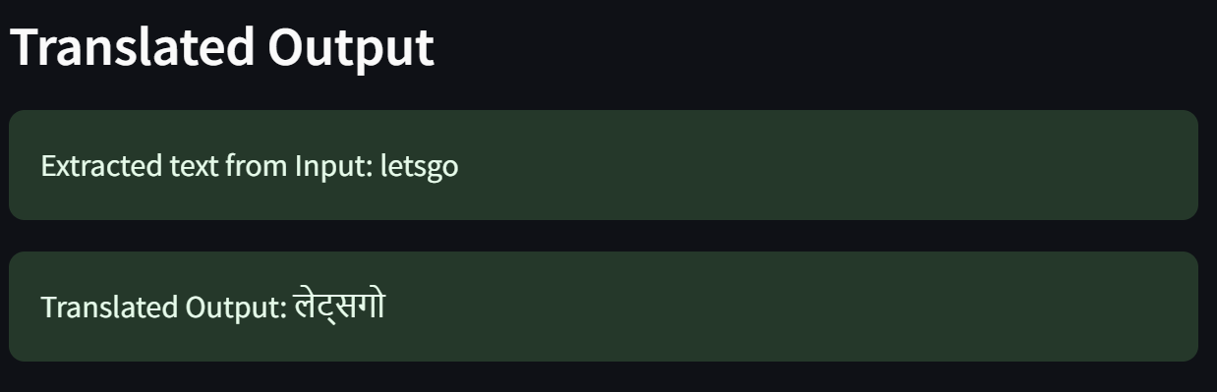
Model Selected:
Uploaded Image

Slide 12

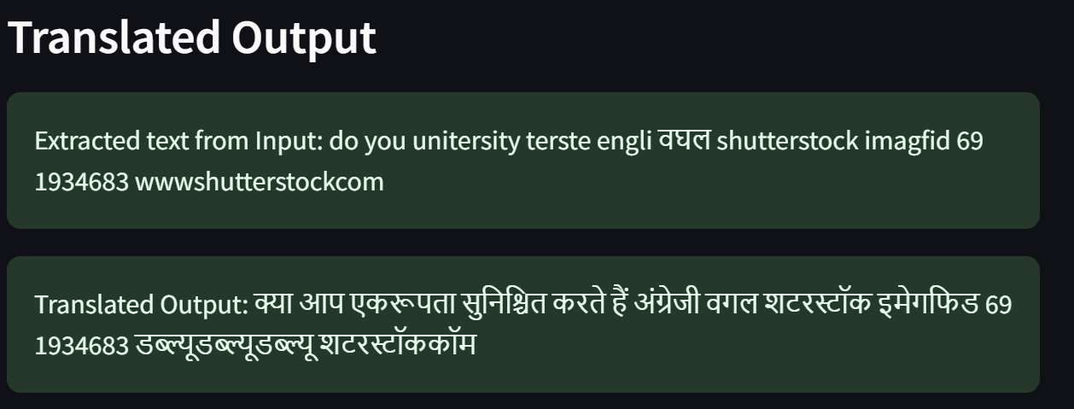
Model Selected:
Uploaded Image

Slide 13

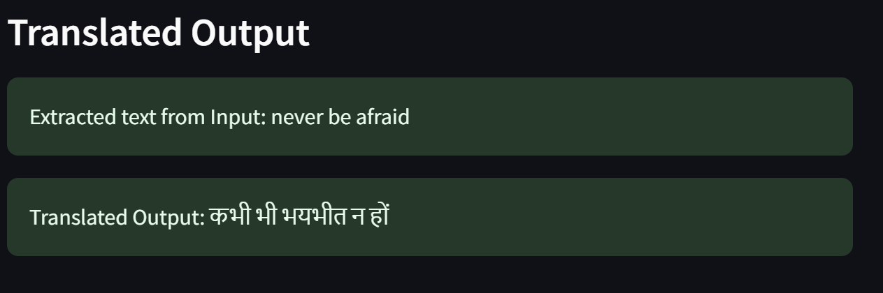
Model Selected:
Uploaded Image

Slide 14

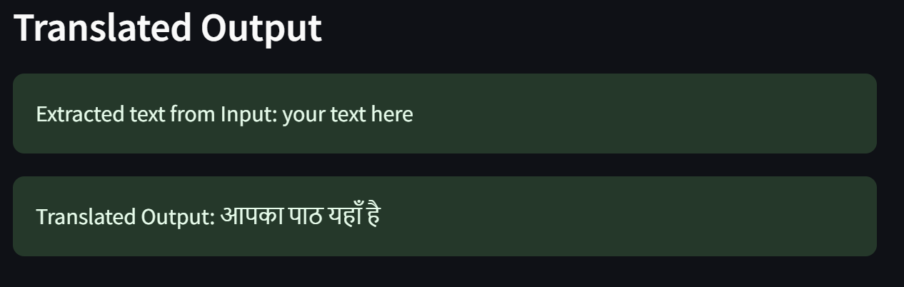
Model Selected:
Uploaded Image

Slide 15
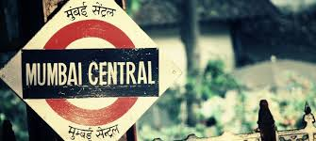
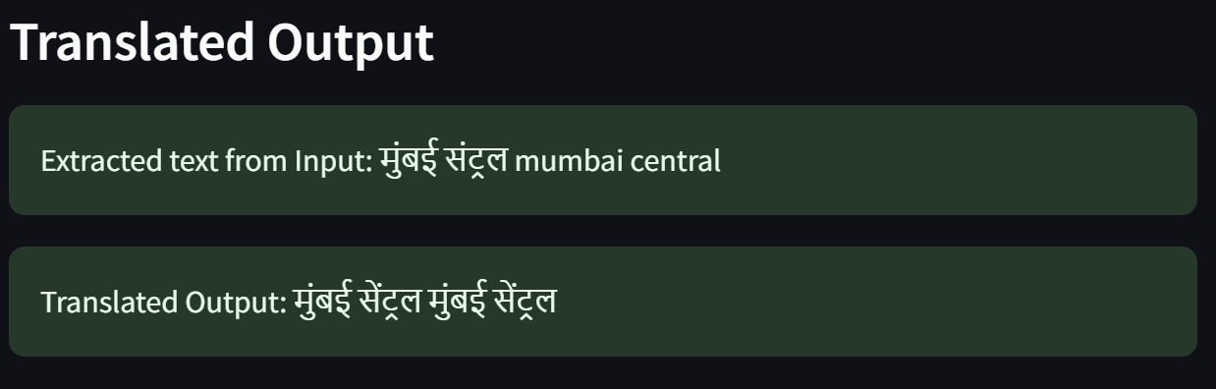
Model Selected:
Uploaded Image

Slide 16

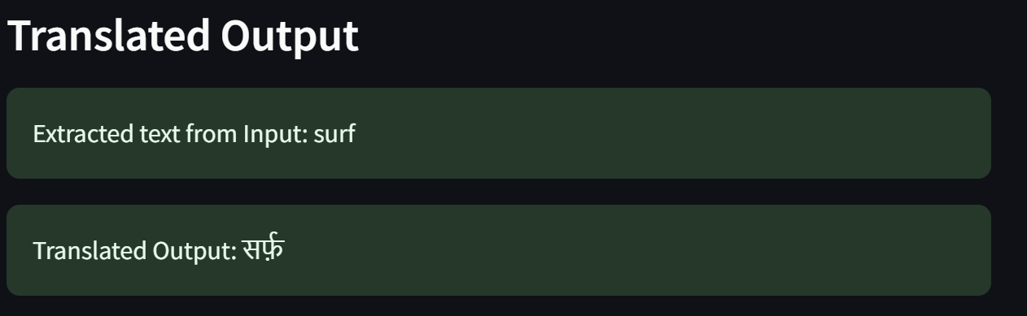
Model Selected:
Uploaded Image

Slide 17

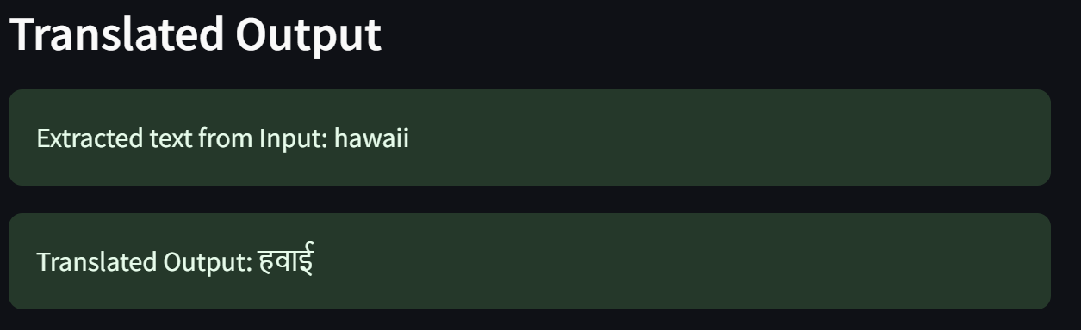
Model Selected:
Uploaded Image

Slide 18

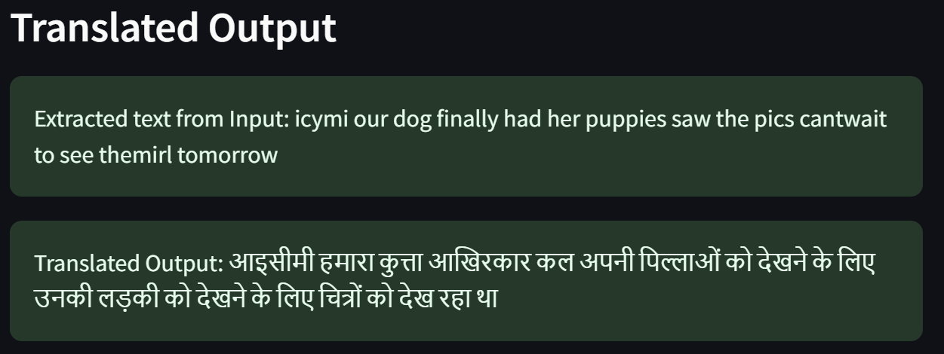
Model Selected:
Uploaded Image

Slide 19
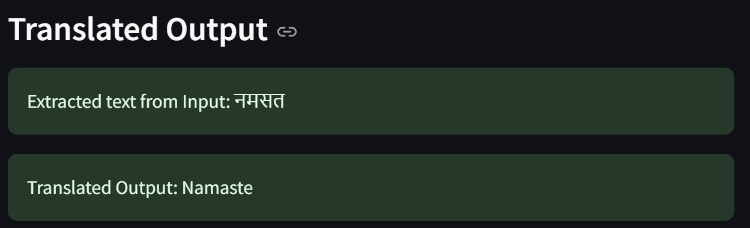
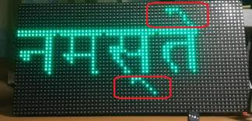
Model Selected: Hindi to English
Uploaded Image

Slide 20

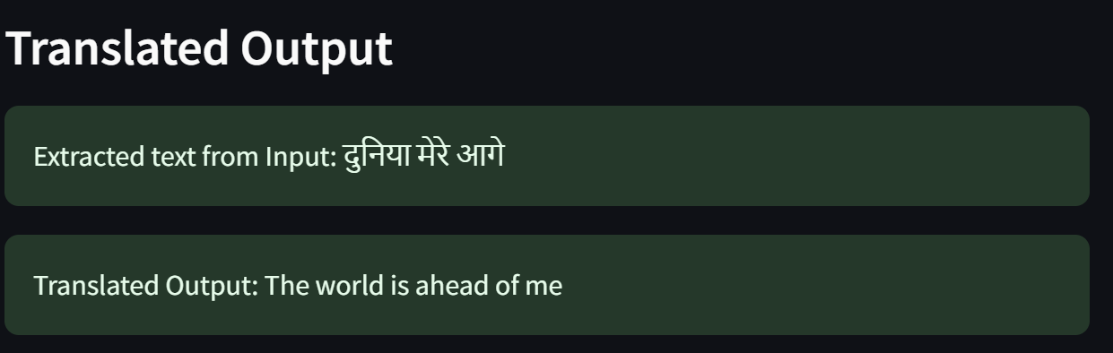
Model Selected: Hindi to English
Uploaded Image

Slide 21

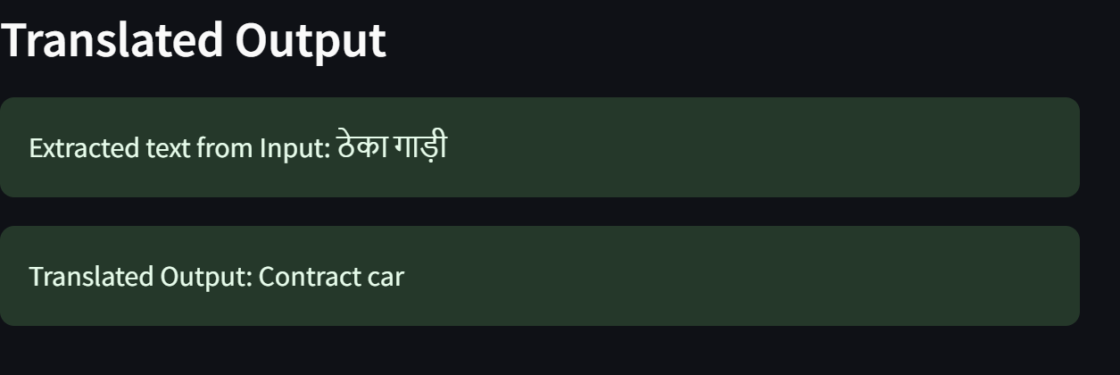
Model Selected: Hindi to English
Uploaded Image

Slide 22

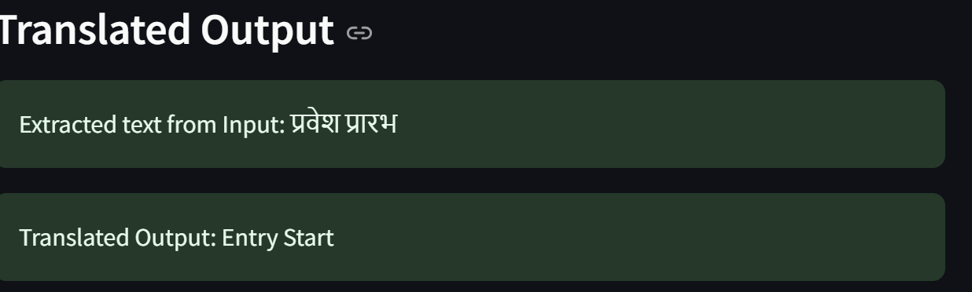
Model Selected: Hindi to English
Uploaded Image

Slide 23
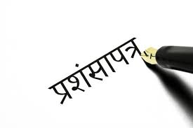
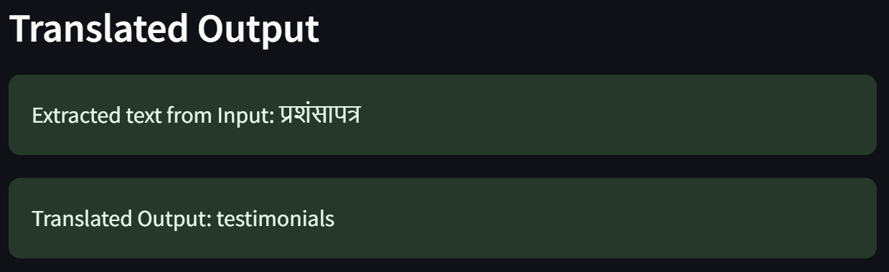
Model Selected: Hindi to English
Uploaded Image

Slide 24

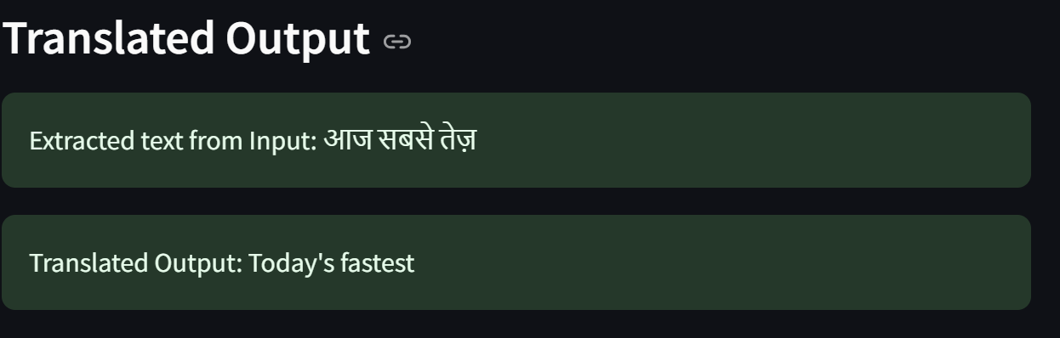
Model Selected: Hindi to English
Uploaded Image

Slide 25
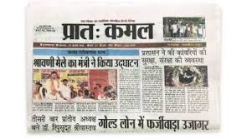
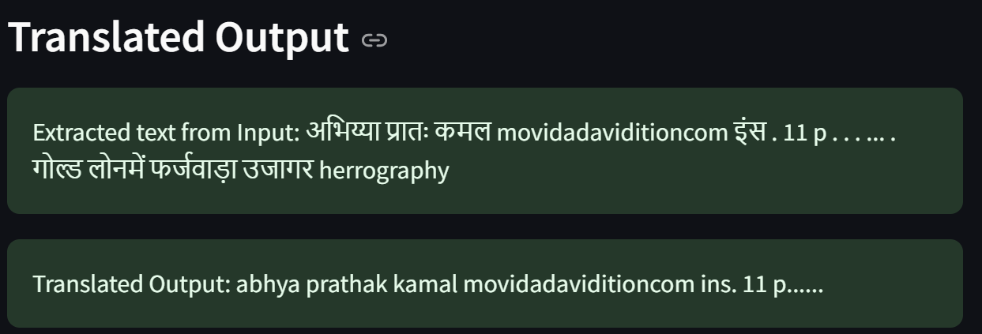
Model Selected: Hindi to English
Uploaded Image

Slide 26

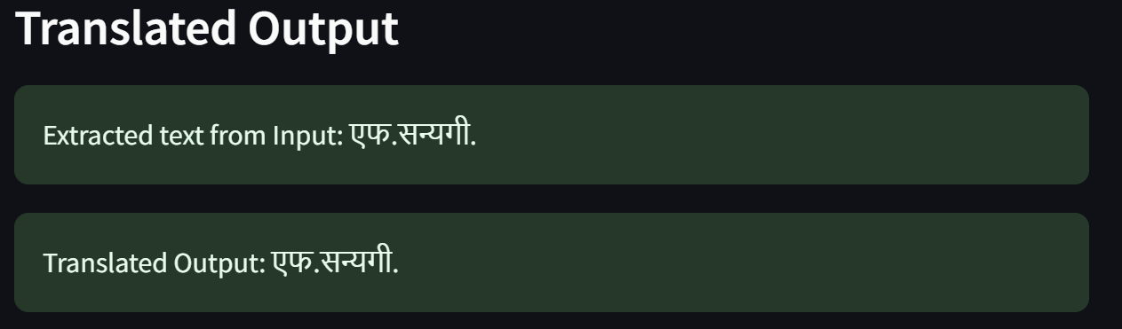
Model Selected: Hindi to English
Uploaded Image

Slide 27
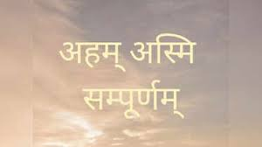
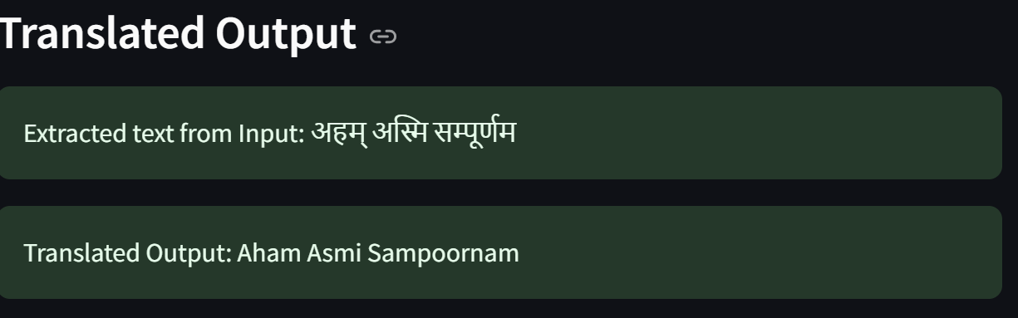
Model Selected: Hindi to English
Uploaded Image

Slide 28

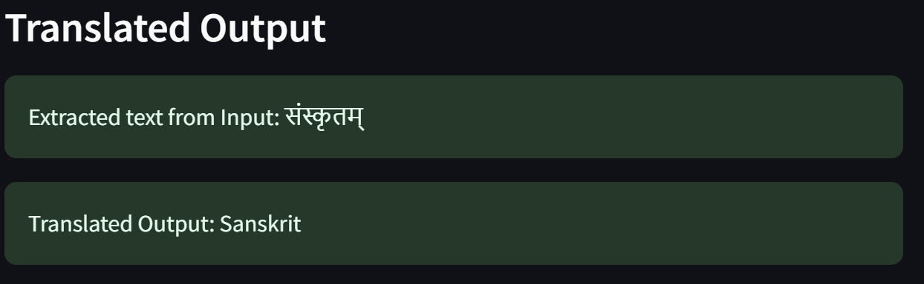
Model Selected: Hindi to English
Uploaded Image

Slide 29

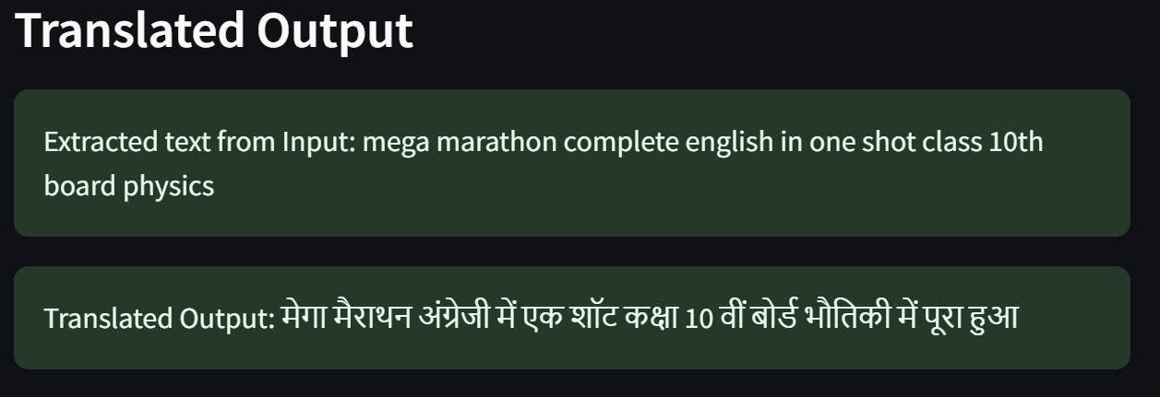
Model Selected:
Uploaded Image

Slide 30

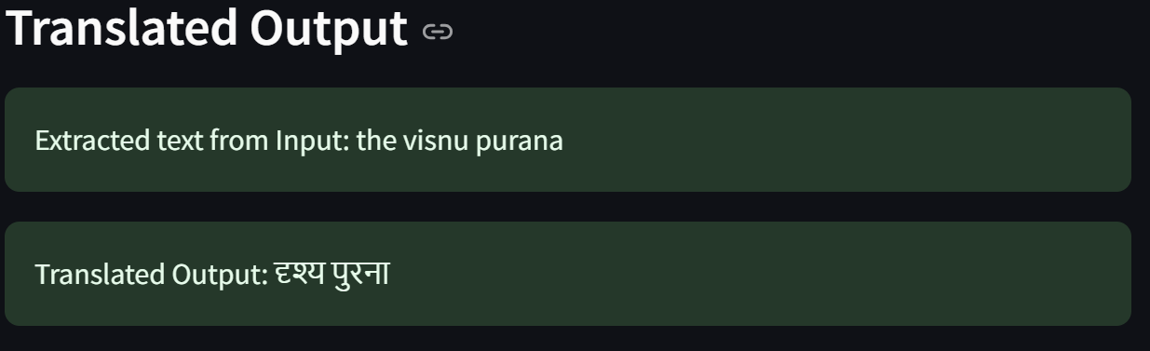
Model Selected:
Uploaded Image

Slide 31

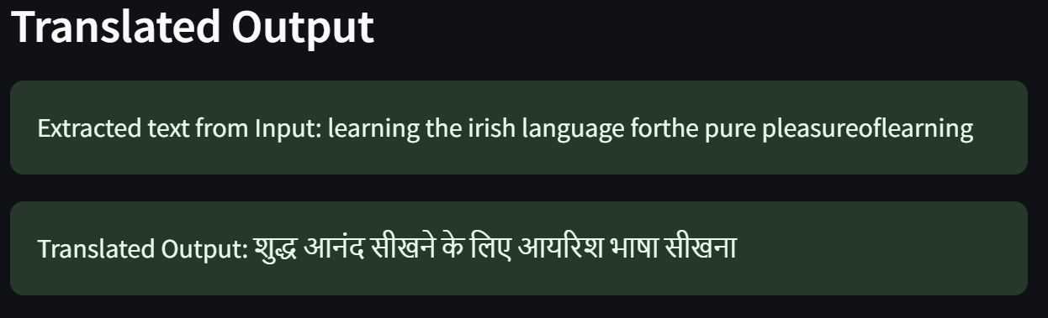
Model Selected:
Uploaded Image

Slide 32

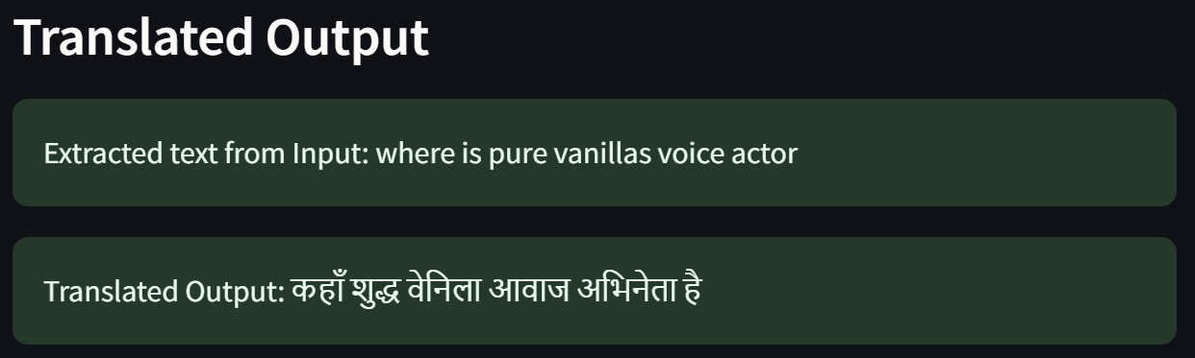
Model Selected:
Uploaded Image

Slide 33

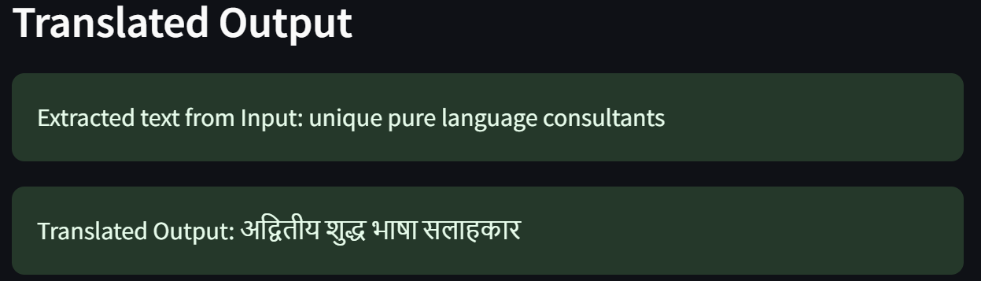
Model Selected:
Uploaded Image

Slide 34

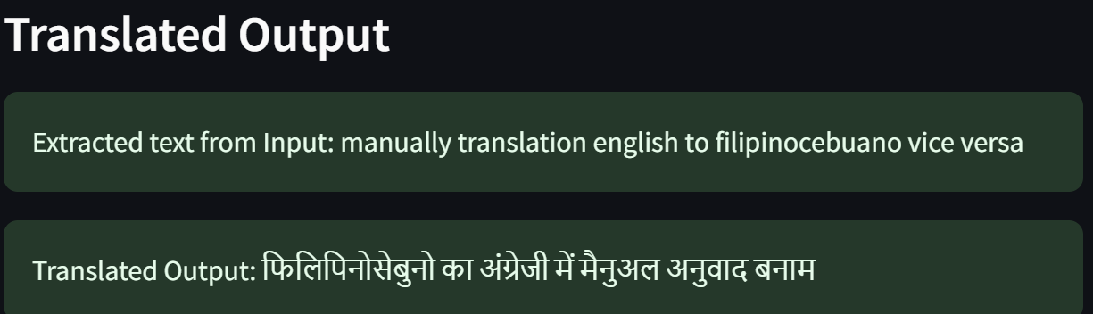
Model Selected:
Uploaded Image

Slide 35

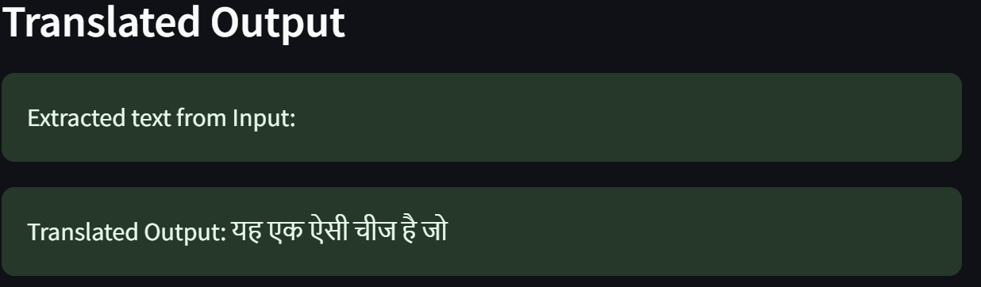
Model Selected:
Uploaded Image

Slide 36

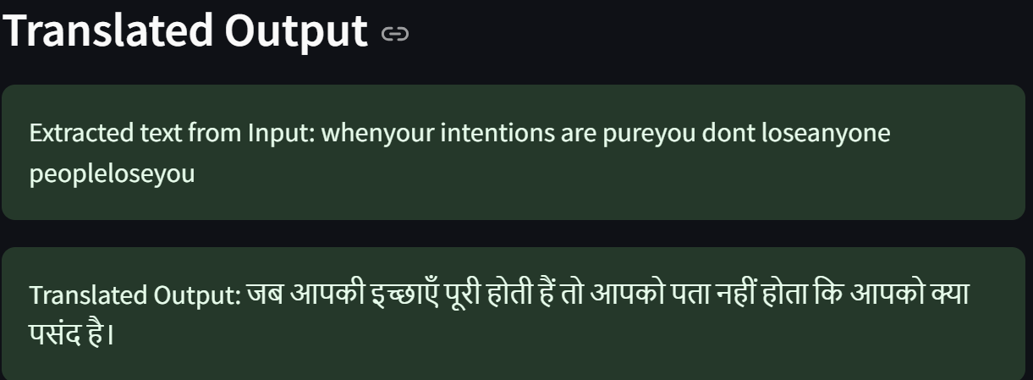
Model Selected:
Uploaded Image

Slide 37

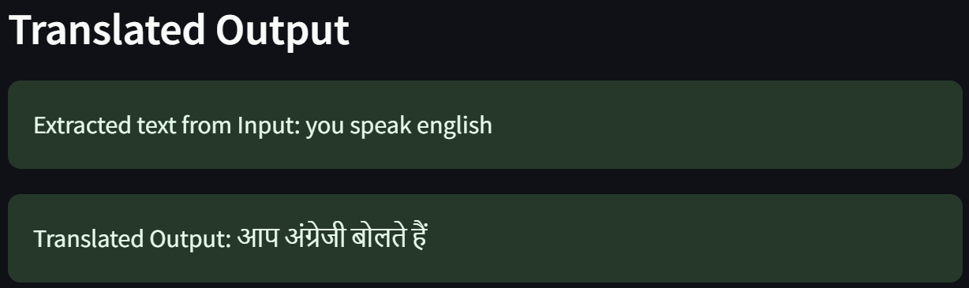
Model Selected:
Uploaded Image

Slide 38

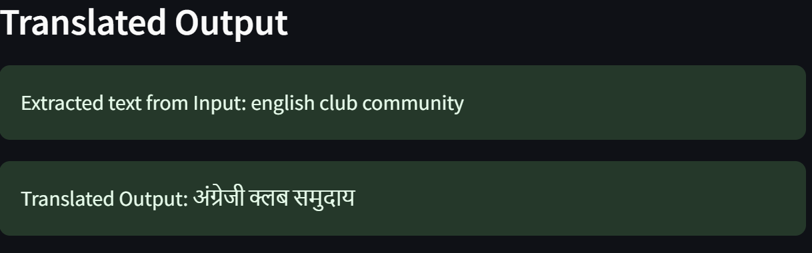
Model Selected:
Uploaded Image

Slide 39

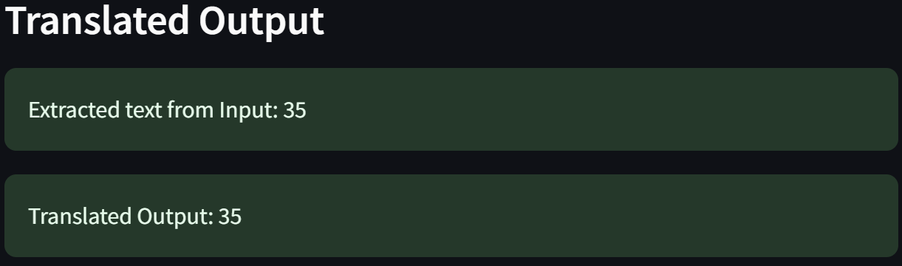
Model Selected: Hindi to English
Uploaded Image

Slide 40

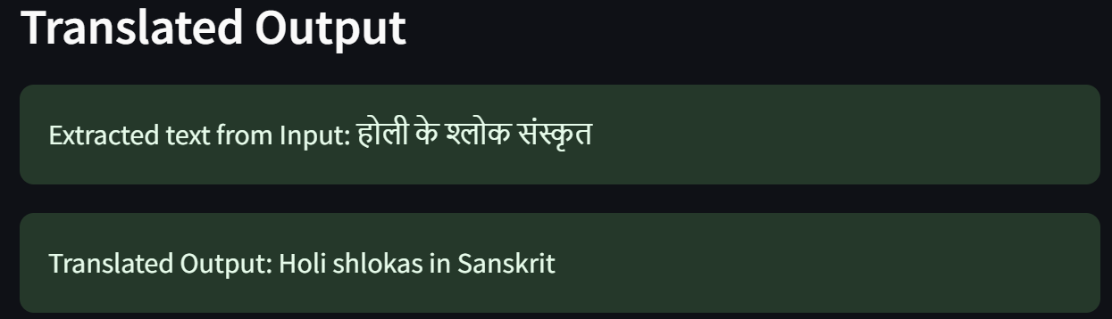
Model Selected: Hindi to English
Uploaded Image

Slide 41

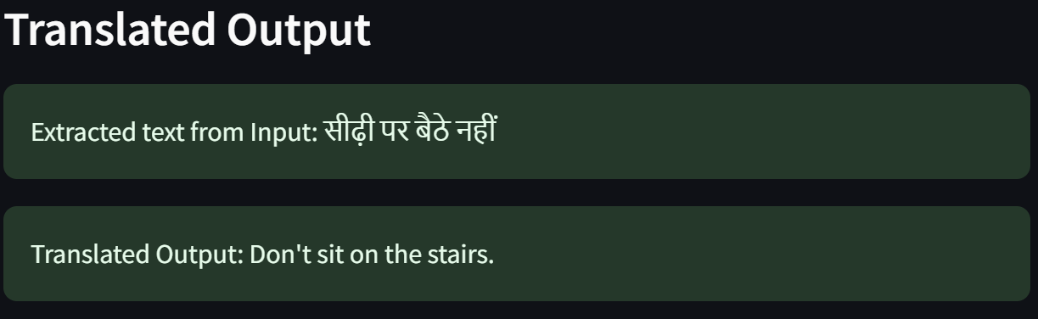
Model Selected: Hindi to English
Uploaded Image

Slide 42

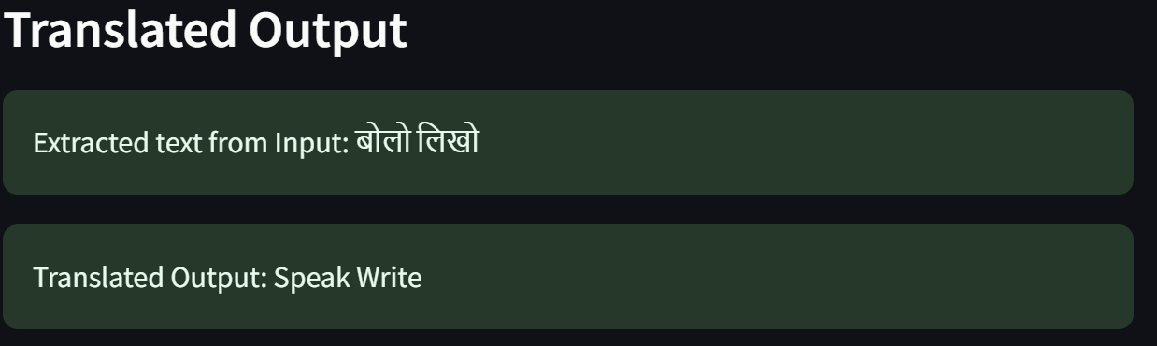
Model Selected: Hindi to English
Uploaded Image

Slide 43
THANK YOU

